Slide 1
Tashkent International School
Back to School Open House
August 2016-17

Slide 2
Technology Integration

Slide 3
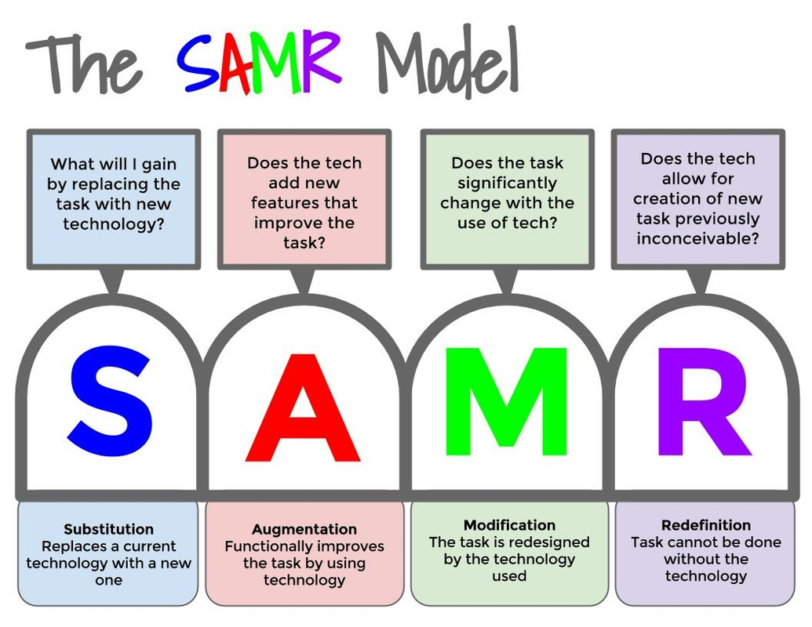

Slide 4
https://www.commonsensemedia.org/videos/introduction-to-the-samr-model#
At which level do you feel most comfortable and why? Pair share
S
A
M
R

Slide 5
A
Tech Integration Plan

Slide 6
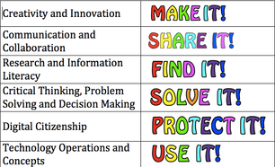
ISTE Standards:
International Society for Technology in Education

Slide 8
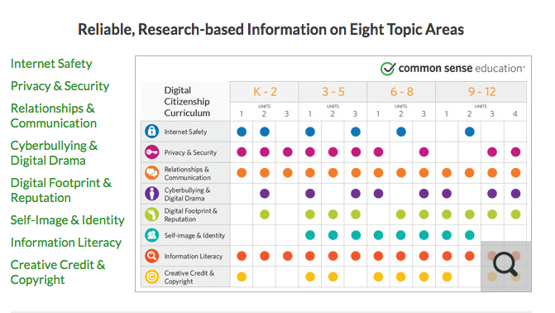
Digital Citizenship - Common Sense.com

Slide 9
Resources
Common Sense - www.commonsensemedia.org
ISTE - www.iste.org
Edutopia - www.edutopia.org

Slide 10
Contact
evanc@tashschool.org

